Slide 1
STRATEGY
BUSINESS FUNCTION

Slide 2
DEFINITION OF STRATEGY
STRATEGIC ANALYSIS
DIGITAL STRATEGY
DIGITAL TRANSFROMATION
REFERENCES

Slide 3
DEFINITION OF STRATGEY

Slide 4
DEFINITION OF STRATEGY
a deliberate search for a plan of action that will develop a business’s competitive advantage and compound it.
working hard to understand a customer’s inherent needs and then rethinking what a category of product is all about.
the determination of the long-term goals and objectives of an enterprise, and the adoption of courses of action and the allocation of resources necessary for carrying out those goals.

Slide 5
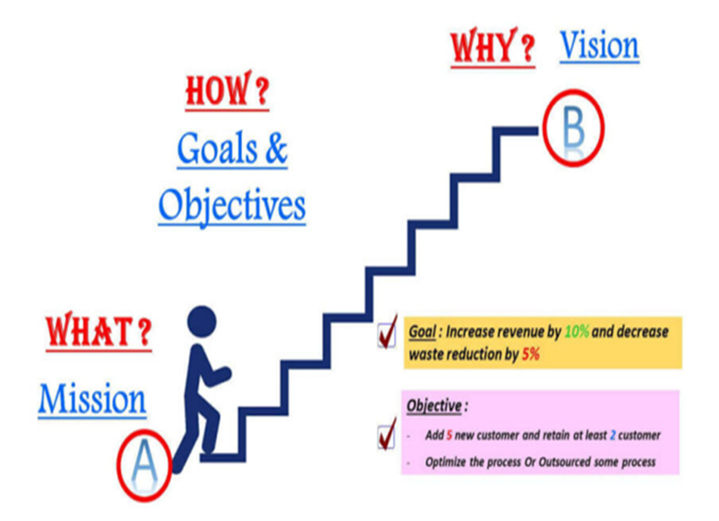

Slide 6
COMPONENTS OF STRATEGY
Mission - Clear sense of what business you are up to. Write (document it) explain to employee and their expected contribution.
Vision - Understanding your long-term objectives and personal goals
Leadership vision – Communicate your vision to employee and stakeholders
Core skills - Ensure the team is able to execute the strategy and combat competition
Key resources - Ensure human, financial and physical resources essential for business success are provided
Environmental scanning – Ability to scan the business environment, collect market intelligence, identify threats and opportunities and develop concrete management strategies to sustain and grow.

Slide 7
ACTIVITY
GROUP ACTIVITY
In your group, discuss each team members mission and vision for their business. Focus on what inspired your vision.
Share with the team your thoughts on what strategy you would need to bring your vision to fruition.

Slide 8
THE FIVE P’S OF STRATEGY
Plan – a carefully crafted set of steps that a firm intends to follow in order to be successful Virtually every firm creates a strategic plan to guide its future. Plans are important to individuals too. If you are reading this, you probably have a career plan that requires a college degree.
Ploy – a specific move designed to outwit or trick competitors A pizzeria owner in Pennsylvania once tried to sabotage his competitors by placing mice in their shops. Although most strategic ploys are legal, this one was not and the perpetrator was arrested.
Pattern – the degree of consistency in a firm’s strategic actions Apple always responds to competitive challenges by innovating. Some of these innovations are complete busts, but enough are successful that Apple’s overall performance is excellent.

Slide 9
THE FIVE P’S OF STRATEGY
Position – a firm’s place in the industry relative to its competitors Old Navy offers fashionable clothes at competitive prices. Old Navy is owned by the same corporation as the Gap and Banana Republic; each brand is positioned at a different pricing level.
Perspective – how executives interpret the competitive landscape around them In the mid-1990s, the Internet was mainly a communication tool for academics and government. Jeff Bezos viewed the Internet as a sales channel and he began selling books online. Today, the company he created-Amazon.com-is a dominant retailer.

Slide 10
CASE STUDY
Blockbuster Inc., from its startup and early growth in the late 1980s, effectively defined and dominated the market for renting movies to watch at home. Up to 1995, sales and profits climbed ever upward, driven by aggressive expansion of the company’s store network, both owned and franchised, voracious acquisition of smaller chains, and entry into many new country markets. From 1995, it proved hard to sustain profitability, and by 2000 pressures on revenues and profits escalated sharply with the launch of Netflix.com, a service that allowed consumers to order movies on the Internet for postal delivery and return.
With the new convenience this offered consumers, and without the costly burden of store real estate and staff, Netflix was able to offer very attractive prices and soon started to steal consumers from Blockbuster. Soon other providers such as Amazon offered a similar service, and Blockbuster found itself fighting for its life. It had no choice but to offer a comparable postal service, adding to the erosion of store revenues in spite of the company’s best efforts to make a positive advantage of the combined channels. As revenues suffered, marginal stores began to lose money, and closures became inevitable.

Slide 11
ACTIVITY
GROUP ACTIVITY
In your group, discuss what Blockbuster could have done to survive.
What are the dangers of ignoring the changes happening around a business?
Do you thing that Blockbuster had a strategy?

Slide 12
STRATEGIC ANALYSIS

Slide 13
STRATEGIC ANALYSIS
Strategic Analysis is: ‘the process of conducting research on the business environment within which an organisation operates and on the organisation itself, in order to formulate strategy.’
NET Business Dictionary

Slide 14
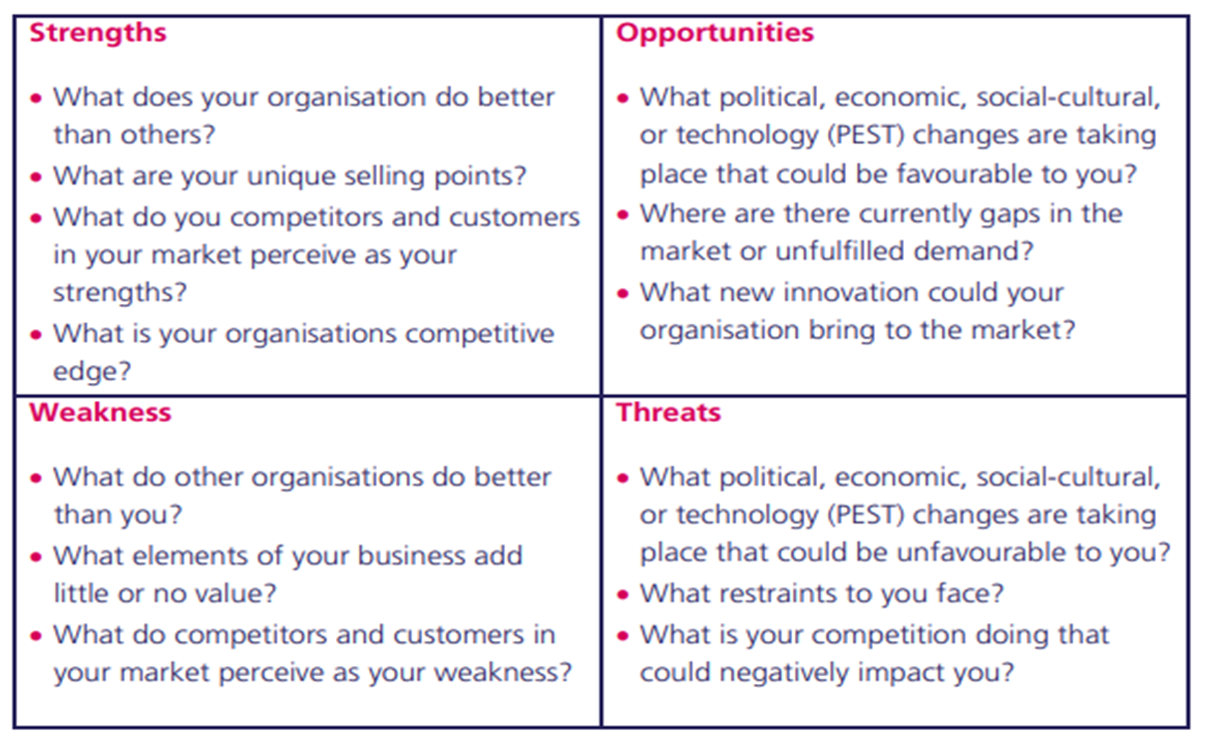
SWOT ANALYSIS

Slide 15
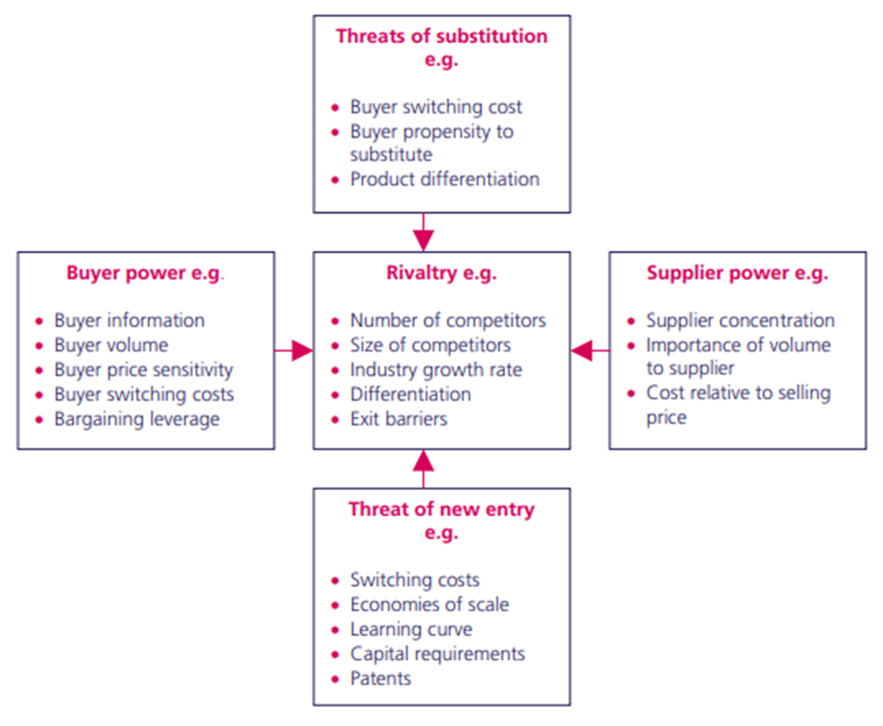
PORTERS FIVE FORCES

Slide 16
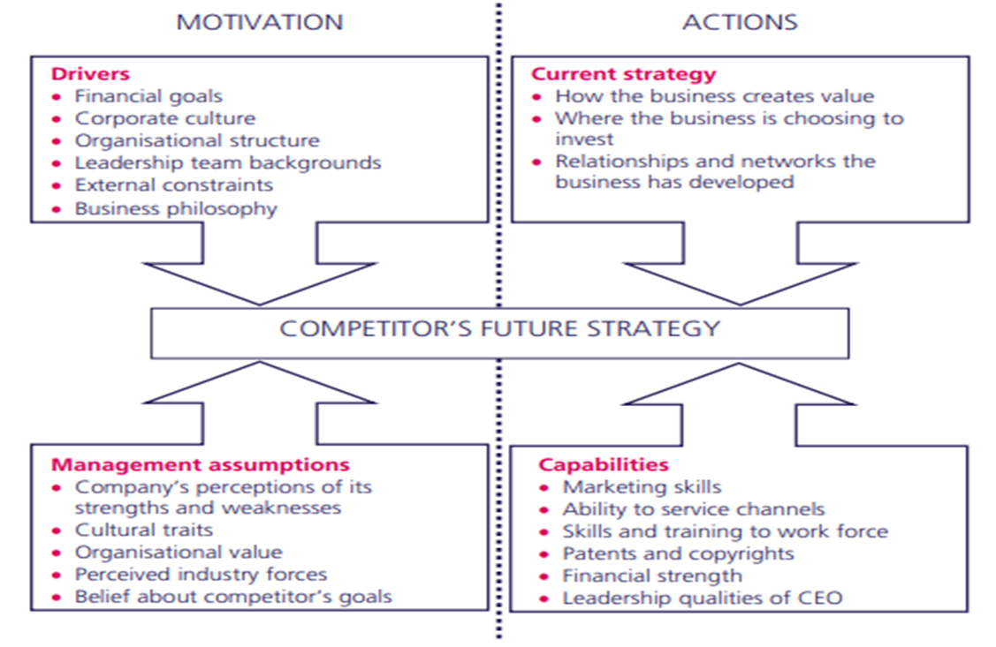
FOUR CORNERS ANALYSIS

Slide 17
DIGITAL STRATEGY

Slide 18
WHAT IS A DIGITAL STRATEGY
a plan that employs digital initiatives to achieve company goals
marketing department would see it in terms of web channels, such as social media and email
finance would think of online revenue tools
the cloud for IT specialists
data analytics for the operations team

Slide 19
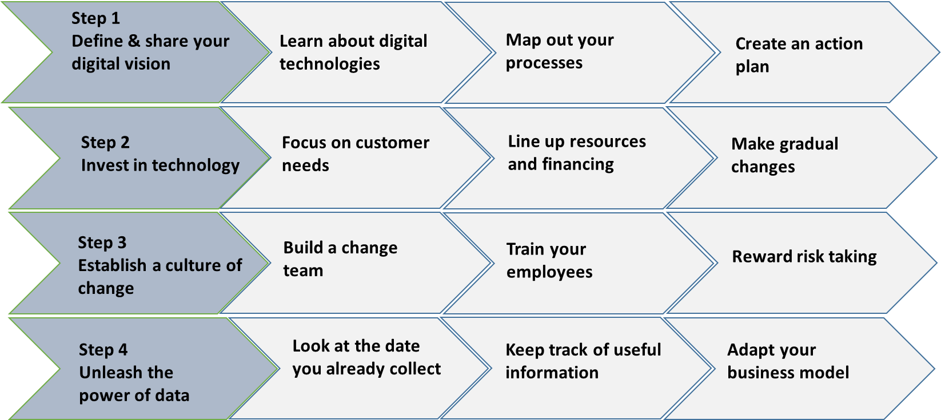
ROADMAP TO DIGITAL STRATEGY

Slide 20
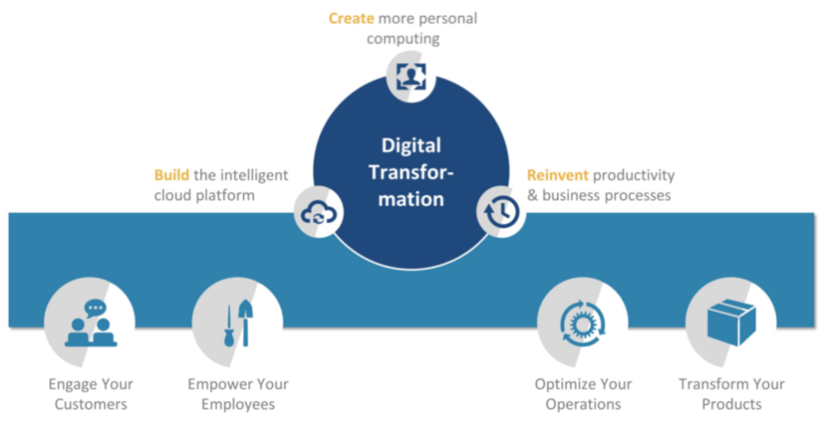
COMPONENTS OF STRATEGY

Slide 21
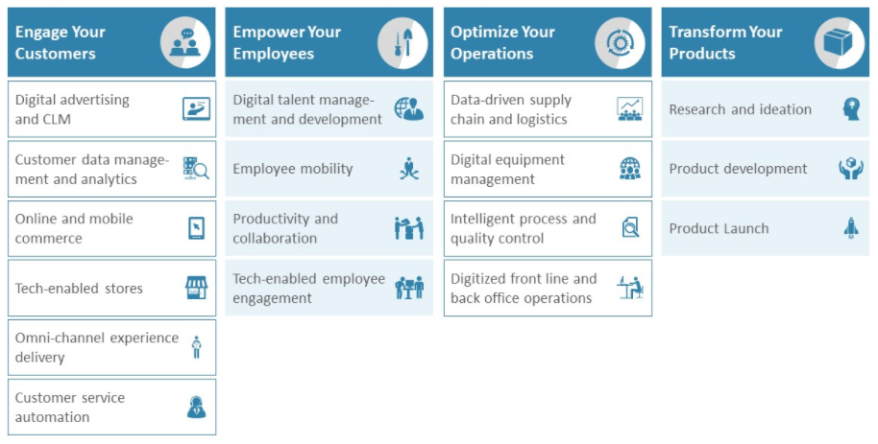
END TO END RELIABILITY

Slide 22
DIGITAL TRANSFORMATION IN BUSINESS

Slide 23
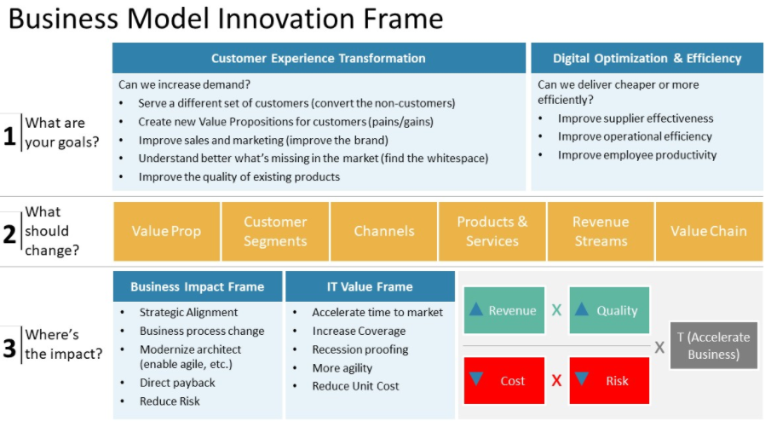
BUSINESS MODEL

Slide 24
ACTIVITY
GROUP ACTIVITY
In your group, identify how a digital transformation would impact on your businesses?
Share with your group a single unexploited opportunity that you have identified for your business and why you have yet made an attempt.

Slide 25
MY ASSETS
How long has your business been in operation for?
Do you have a strategy for your business?
Do you think you need a strategy for your business?
Do you use digital equipment or platforms to run your business?
Would you want to increase the amount of technology your business uses?
Would it improves profits?
Do you have the skills in your business to develop a digital strategy?
Are your competitors transforming to digital?

Slide 26
REFERENCES

Slide 27
REFERENCES
Mission Vision Goals and Objectives Mission Vision Goals and Objectives | Digital E-Learning (digitalelearnings.com)
Business Strategy Examples (And Why It’s Important to Have One.
https://www.indeed.com/career-advice/career-development/business-strategy-examples
Drivers of digital adoption: a multiple case analysis among low and high-tech industries in Malaysia https://www.emerald.com/insight/1757-4323.htm
Key business drivers– major impact on business performance: managing–must factors: value, growth, innovation, cost…https://bizshifts-trends.com/key-business-driver-major-impact-business-performance-managing-value-innovation-growth-sustainability/
The 7 Principles of Digital Business Strategy & Transformation (slideshare.net)
Major Reasons Your Business Needs A Digital Strategy http://blog.actuatedigital.co.ke/2016/09/01/why-your-business-needs-a-digital-strategy/
Digital Readiness Assessment: The First Step Toward a Future-Ready Workforce https://blog.mettl.com/digital-readiness/
Change Made in Shop Floor Management to Transform a Conventional Production System into an “Industry 4.0” http://dx.doi.org/10.1109/ICITM.2018.8333919

